Slide 1
Food Delivery Chatbot
Group-4
Pradnya Patil
Akshay Sonawane
Nikita Kodam
Mrunal Chaudhari

Slide 2
Chatbots
A chatbot is artificial intelligence (AI) software that can imitate a natural language discussion (or chat) with a user via messaging apps, websites or mobile apps.
Why Chatbots?
For faster and transparent order processing
To know order patterns and to keep track of loyal customers
To assess customer feedback.
Foodtech chatbots are more interactive, easy to use, scale ,and can be easily automated.

Slide 3
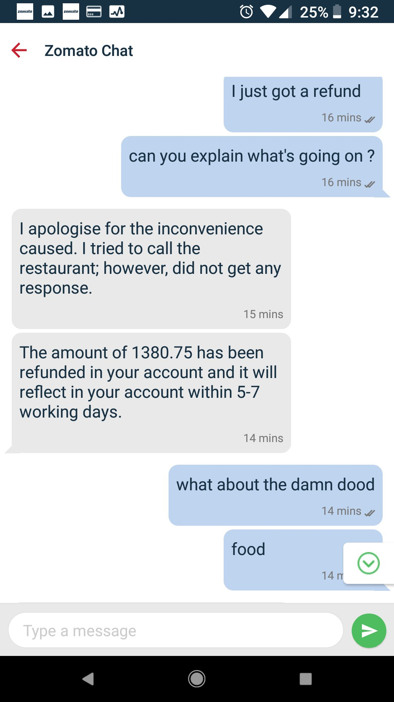
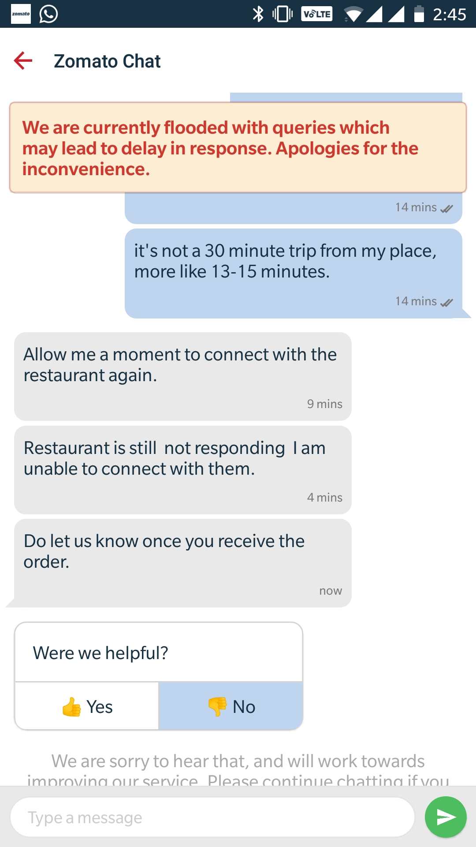
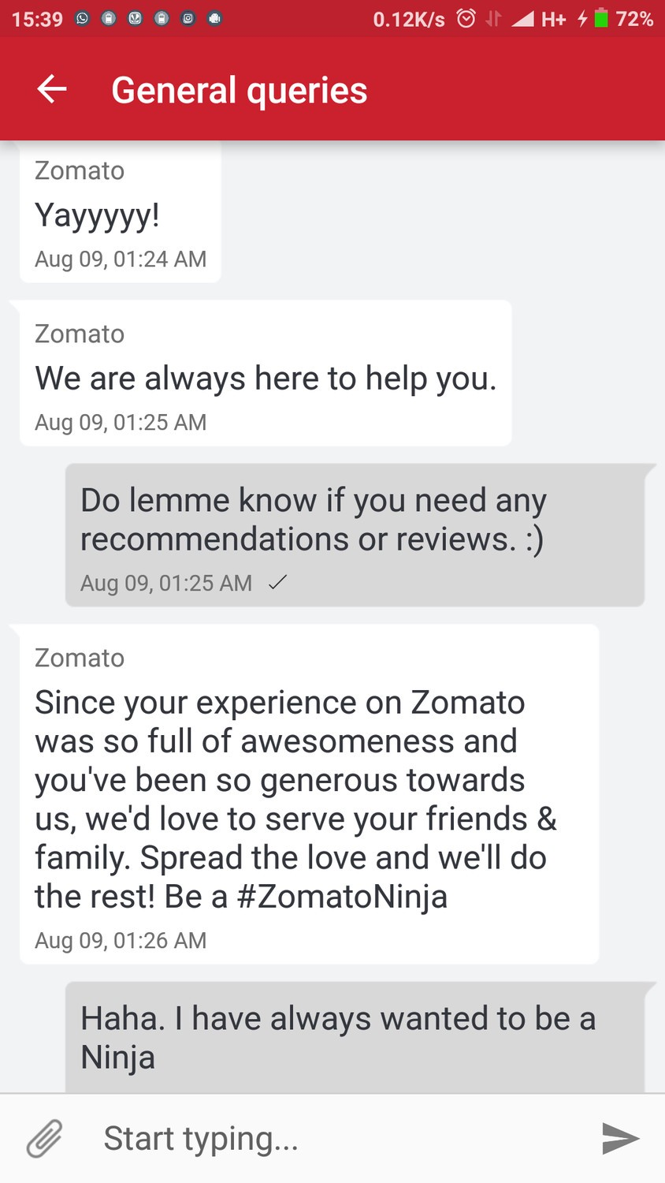
Zomato Chat:

Slide 4
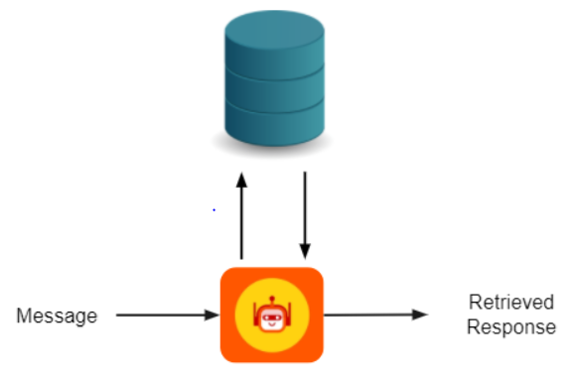
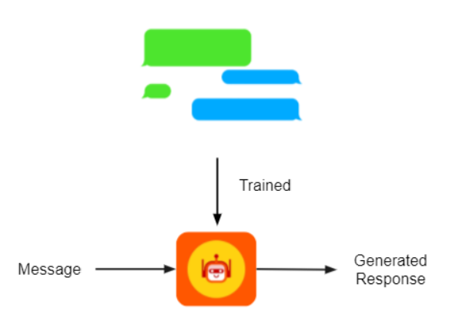
Types of Chatbots
Generative based
Generative chatbots use a combination of supervised learning, unsupervised learning & reinforcement learning. A generative chatbot is an open-domain chatbot that creates unique language combinations rather than selecting from a list of pre-defined responses.
Chatbots that use generative methods can generate new dialogue based on large amounts of conversational training data.
Retrieval based
Retrieval-based systems are limited to predefined responses.
In this we can use Intent Recognition method. Intent classification or intent recognition is the task of taking a written or spoken input, and classifying it based on what the user wants to achieve
Source: https://www.techlearn.live/

Slide 5
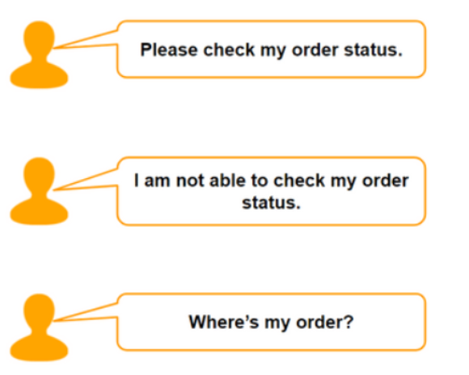
Method 2: Retrieval based chatbot
This can be done using Intent classification. Intent classification or intent recognition is the task of taking a written or spoken input, and classifying it based on what the user wants to achieve.
They all want to check their order status
They all want to check their order status
Chatbot using Intent classification
Chatbot using Intent classification
Intent.json
{"intents": [ {"tag": "greeting",
"patterns": ["Hi", "Good morning!“],
"responses": ["Hello I'm Restrobot! How can I help you?", "Hi! I'm Restrobot. How may I assist you today?"] }
Pre-processing
(normalization, stop words, lowercase, lemmatization)
Classification model to get the intent of customer’s message
Vectorization
Sentiment analysis
Generate the response based on intent and question
Restaurant database

Slide 6
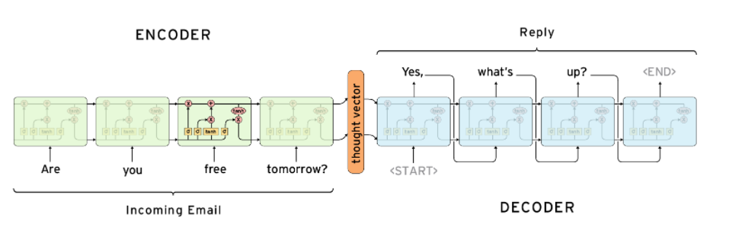
Method 1: Generative method based chatbot
As we have seen, Chatbots that use generative methods can generate new dialogue based on large amounts of conversational training data. Here, we can use Sequence to sequence learning.
Sequence to Sequence Learning:
The Sequence to Sequence model (seq2seq) consists of two RNNs - an encoder and a decoder.
The Encoder reads the input sequence, word by word and emits a context (a function of final hidden state of encoder), which would ideally capture the essence (semantic summary) of the input sequence.
Based on this context, the Decoder generates the output sequence, one word at a time while looking at the context and the previous word during each timestep.
Incoming message
Source: parctical seq2seq

Slide 7
Datasets
Json file with intents : dataset
Cornell movie dataset for Seq2Seq model : dataset

Slide 8
Using combination of both Method 1 and 2
Query/message from customer
Preprocessing and Vectorization
Intent classification
If intent present In the dataset
NO
Use seq2seq model
Yes
Generate response from intent.json

Slide 9
Project Architecture / Project Flow

Slide 10
Intent Classification
Intents list: Dataset
Greetings
Table booking
Table availability
Menu
Contact and address details
Offers
Positive/Negative feedback
Veg/nonveg/vegan food enquiry
Order status
Suggestions
Queries related to payments, recipes, delivery
Closure
Ratings

Slide 11
Input data
intents.json
Intent Classification
fastText
Library for learning of word embeddings and text classification
Embedding.py
parse_data()
embed_sentence()
write_embedded_data()
RASA NLU
Embedded output
Embedded_data.json
Classifier.py
TODO
Gensim
Preprocessor.py
lemmatize_sentence()
tokenize_and_remove_punctuation()
remove_stopwords()
Greetings
Feedback
queries
Message from the user
Response from the chatbot
Response_generator.py
Message
Response
Front End
Message
FLASK (app.py)
Food menu
Table availability
Offers
Suggestions
Restaurant Database
Response
Response generation

Slide 12
Short JSON file and Clustering of Intents
{"intents": [
{"tag": "greeting",
"patterns": ["Hi", "Hey", "Hello", "Good morning!", "Hey! Good morning", "Hey there", "Hey Janet", "Very good morning", "A very good morning to you", "Greeting", "Greetings to you"],
"responses": ["Hello I'm Restrobot! How can I help you?", "Hi! I'm Restrobot. How may I assist you today?"]
},
{"tag": "book_table",
"patterns": ["Book a table","Can I book a table?", "I want to book a table", "Book seat", "I want to book a seat", "Can I book a seat?", "Could you help me book a table", "Can I reserve a seat?", "I need a reservation", "Can you help me with a reservation", "Can I book a reservation", "Can i have a table?", "Help me reserve a table", "book table"],
"responses": [""]
},
{"tag": "goodbye",
"patterns": ["cya", "I will leave now","See you later", "Goodbye", "Leaving now, Bye" , "Good bye dear", "Bye dear","I am Leaving", "Have a Good day", "cya later", "I gotta go now", "I gotta rush now", "Thank you, bye", "Bye", "Ok Bye", "Okay goodnight", "Have a good day ahead", "Have a great day", "Tata", "Take care"],
"responses": ["It's been my pleasure serving you!", "Hope to see you again soon! Goodbye!"]
},
{"tag": "negative_feedback",
"patterns": ["what the fuck is wrong with these noodles?", "The choco lava was so undercooked", "Ew such a waste of money man", "too salty", "we were served cold food", "so disappointed", "the food is pathetic", "hate it"],
"responses": ["Thank you so much for your valuable feedback. We deeply regret the inconvenience. We have forwarded your concerns to the authority and hope to satisfy you better the next time!"]
},
{"tag": "offers",
"patterns": ["Could you tell me the pocket friendly options?","Are there any discounts going on?", "Are there any special offers today?", "What about the festive offers?", "Could you please tell me which foods are on discount?", "are there any discounts", "are there any discount offers", "do you have any offers?", "what are the offers going on?", "what are the discounts available?"],
"responses": [""]
},
{"tag": "veg_enquiry",
"patterns": ["Can I see the vegetarian options?","Do you have any vegetarian options??", "Please show me your best vegetarian foods", "I dont want to eat non veg", "I am vegetarian", "vegetarian", "is this place vegetarian?"],
"responses": [""]
}
]
}

Slide 13
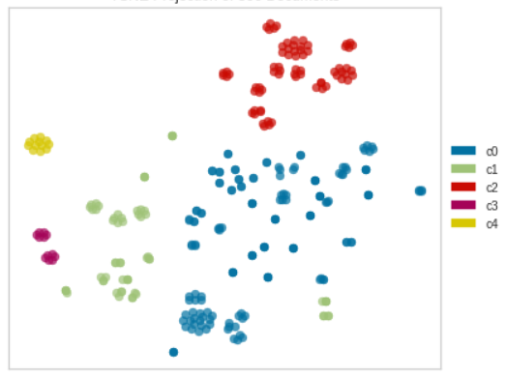
TSNE Projection : Notebook

